Slide 1
FHIM Model Driven Architecture
Proof of Concept Use Case:
Allergy Intolerance
June 2016
DRAFT v 17: Not approved for distribution

Slide 2
Executive Summary
Proof of Concept (PoC) employs a common logical/clinical model
Defines the shared semantics between alternative interoperability formats
PoC Scope: JET allergen use case as defined by DoD/VA FHIR proving task force
Scalable and maintainable approach
Clear and unambiguous content for:
Standards developers
Interoperability solution implementers
Reusable and extensible deliverables of PoC include:
Model to Text report generation component
Model to Model MDMI Framework
Notes:
Successful proof of concept (PoC) employing a common logical/clinical model to define the shared semantics between alternative interoperability formats
PoC Scope: JET allergen use case as defined by DoD/VA FHIR proving task force
Scalable and maintainable approach was developed and employed that provided clear and unambiguous content for standards developers and interoperability solution implementers
Reusable and extensible deliverables of PoC include:
Model to Text report generation component
Model to Model MDMI Framework

Slide 3
FHIM/FHIR MDA Proof of Concept
Goal Achieved:
Developed a repeatable and extensible process to leverage MDHT and MDMI (MDA) to support and improve the analysis and production of health exchange standards
Supporting Tasks Performed:
Modeling Task: Annotate UML models from the FHIM and FHIR (via MDHT) projects to provide independent semantic clarity
Software Task: Using the annotated models as input, produce a traceability and gap analysis report and an implementation specification (MDHT UML FHIR Profile)
Notes:
FHIR – Fast Healthcare Interoperability Resources
MDA – Model Driven Architecture
MDHT – Model Driven Health Tools
MDMI – Model Driven Message Interoperability
UML – Universal Modeling Language

Slide 4
Proof of Concept Scope
Clinical Use Case
Allergy Intolerance and Reactions
FHIM UML Resources
Allergy Domain Model
MDHT
DSTU2 DAF* UML Model for FHIR
MDMI
Business elements for allergy intolerance domain
* DAF – Data Access Framework
Notes:
Allergy Intolerance Use case was chosen because there was recent work done in this area by members of the FHIM and might allow some reference as to the potential value of enhancements to the FHIM and the analysis and requirements of information exchange between the agencies.

Slide 5
MDA Proof of Concept Deliverables
Working Software (Reusable & Extensible)
Model to Text report generation component
Model to Model MDMI Framework
Completed Artifacts
Generated Traceability and Gap Analysis Report for Allergies
Generated UML FHIR Profile for Allergies
FHIM UML Model annotated with MDMI for Allergies
FHIR UML Model annotated with MDMI for Allergies
Report
Use Case Report detailing efforts and findings
Notes:
The POC for the MDA framework was to leverage and extend the existing assets available to and investments made by the ONC and the other federal agencies. The POC leverage existing working software used in the SAMSHA work using the MDA framework to automate creating logical semantic models from FHIR (and other Information Models such as CCDA and the FHIM) as well as in the HL7 SOA Cross Paradigm Interoperability Project which provided the traceability component of the Traceability and Gap Analysis Report. Additionally, the MDHT assets used by the ONC, the VA, NIST, and others is an integral part of the MDA Framework. The existing FHIM asset was also incorporated into the framework.

Slide 6
The Repeatable Process Framework
A Repeatable 4-Step Process:
Annotate FHIM Model (Once)
Annotate Target Model (FHIR, or other)
Using FHIM and Target
Generate Traceability and Gap Analysis
Generate Implementation (if applicable)
Using Target
Generate MDMI Map*
Repeat Steps 2 through 4 for other target models (C-CDA, VA, DOD, etc.)
* Generate MDMI maps to enhance interoperability exchange development
Notes:
The previously implemented transformations use specific metadata embedded within FHIM models to support the transformation to a target model. The proposed FHIM to FHIR transformation using MDMI is based on an initial proof-of-concept architecture framework that requires several steps:
1 Annotate the FHIM using MDMI RI
2 Annotate the target platform specific model using MDMI RI
3 Designate FHIM elements to be transformed
4 Using the FHIM MDMI Annotations, identify the corresponding target UML structure(s)
5 Using a target specific compare extension, identify the series of element additions, deletions, and modifications
6 Using a target specific model extension and the list of elements, generate the target platform UML for the profile classes
7 Use the target platform UML transformation to generate the corresponding artifacts, e.g. FHIR StructureDefinition

Slide 7
FHIM to FHIR via MDMI Framework
FHIM
MDMI Framework
FHIM
To
Target
Deltas
Implementation
FHIR Profile
RI *
Compare
Generate
Target
Uses
Uses
Creates
Uses
FHIR DSTU
FHIR
Compare
FHIR
Generate
Profile
* RI – Referent Index
Notes:
Reference Index RI is shared data dictionary from the MDMI specification
The generated FHIR Profile is a MDHT/FHIR UML Model – MDHT/FHIR supports the generation of the FHIR specific artifacts
The framework can be extended to support other targets and generation implementations – NIEM for instance

Slide 8
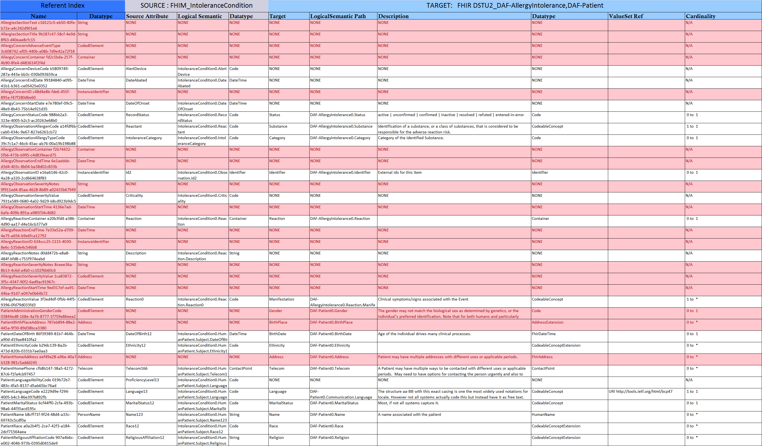
Traceability and Gap Report Depiction
Notes:
The report has three components – Reference Index Columns, Source, and Target - The source and target contains the same targets
The highlighting is to help identify differences
The RI content comes for the MDMI RI cloud service
The source and target content comes from the MDMI maps themselves
These MDMI maps can also be leveraged as part of the MDMI runtime to transform from one implementation to another
Referent Index Columns
Name
Description
Datatype
ValueSet Ref
SOURCE and TARGET columns
Source Attribute
Logical Semantic Path
Description
Datatype
ValueSet Ref
Cardinality
Interoperability Measure – Analysis of the level of alignment between source and target (matched, unmatched, wider, narrower )

Slide 9
Benefits & Lessons Learned
Benefits:
Portable Traceability and Gap analysis
FHIM to C-CDA, C-CDA to FHIR using same components
The FHIM supports the business analysis of allergy domain and identification of relevant data elements in an automated and repeatable fashion across:
Multiple agencies
Multiple domains
Lessons Learned:
Comparison needs better terminology services
Notes:
Benefits
The Traceability and Gap analysis can be generated using any two MDMI based maps
This is not limited to FHIM
Lessons Learned
Terminology and terminology services are a key missing ingredient to a comprehensive interoperability solution. There is no single source or even a set of sources which can be used to determine the content of
Value sets as well as a variety of vague terminology binding approaches leveraged in the various specifications
Integrating PHINVADS and VSAC as well as improving bindings would be able to provide a clearing house service for value set definitions and there bindings and where they are leveraged
Some additional Lessons Learned
The proof-of-concept framework is viable and can be extended to provide a scalable, flexible MDA framework for assisting the FHA and its partner agencies in understanding the quality and potential gaps in different information exchange use cases between federal agencies. For example, the team was able to produce a FHIM to Consolidated Clinical Document Architecture (C-CDA) report based on previous work completed for a Substance Abuse and Mental Health Services Administration (SAMHSA) project, and using the C-CDA UML model created using MDHT authoring tools.
It should be possible to extend the MDA framework so that the agency Subject Matter Experts can use the tooling to complete the entire analysis, as well as use the tooling to provide subsequent reports that summarize traceability issues and gaps that must be addressed.
The FHIM works quite well as the Reference Information Model (RIM). This is especially obvious when compared with other models analyzed, e.g. C-CDA.
Improving the quality of the traceability report may require organizations outside the US Federal Government to make enhancements. For example, good descriptions for FHIR semantic concepts were not available via a known interface.
The current Interoperability Measurement Column data was manually entered. It was determined that the value for this column can be computed from other metadata, however that design and implementation work was beyond the scope of this first project.
There needs to be an additional report column that will provide more information about semantic relationships in the various models. For example, where a semantic concept represents a person’s legal name or a person’s common name is sometimes embedded in the value of a datatype attribute. This information should be provided in an additional Column in the Report for each Information Model. There are also other examples similar to this.
Descriptions were used to associate semantic concepts in the MDMI Referent Index with semantic concepts in the Information Models. The MDMI Referent Index contains Semantic Metadata for each semantic concept. It is recommended that this information be added to help the Subject Matter Experts in their goal of ensuring the accuracy and quality of the information to be exchanged.
Drawing from previous SME experience, the mapping framework can be used for interoperability analysis not only with Information Models represented in UML, but it also may be used for analysis with information exchange formats that do not have a UML representation, for example HL7 v.2.x, X.12, and proprietary EHR data formats in use by FHA partner agencies.

Slide 10
Proof of Concept Summary: Importance of Operationalizing the FHIM
Developed a scalable and maintainable approach
Validated concept
Provided clear and unambiguous content for:
Standards developers
Interoperability solution implementers
Reusable and extensible deliverables of PoC include:
Model to Text report generation component
Model to Model MDMI Framework
Approach was validated by operationalizing the JET allergen use case as defined by the DoD/VA FHIR proving task force
Notes:
PoC had validity by limiting its scope to a practitioner relevant context, the JET Allergen Use Case
PoC approach is generalizable to any agency or health domain
A scalable and maintainable approach was developed and its concept validated that provided clear and unambiguous content for standards developers and interoperability solution implementers
Reusable and extensible deliverables of PoC include:
Model to Text report generation component
Model to Model MDMI Framework
The generalizable approach was validated by with the JET allergen use case as defined by the DoD/VA FHIR proving task force

Slide 11
Recommendations
Operationalizing the FHIM with MDA
Agency targeted review of content and tooling
Complete design and implementation of FHIR specification import/export to UML for HL7 balloted FHIR STU 3
Enhance functionality of automated FHIR profile generation
Integrate terminology services for analysis of value set mapping
Expand scope and use of FHIM content mapping
Enhance traceability and gap analysis reporting
Notes:
Agency Targeted review of content and tooling
Demonstration, design review, code walk-through
Expand scope and use of FHIM content mapping
Expand annotation of FHIM and FHIR models beyond allergies
Pilot project with government agency SME users
Enhance traceability and gap analysis report
Interoperability measurement column, Condition column, more complete information from FHIR and C-CDA models
Complete design and implementation of FHIR specification import/export to UML for HL7 balloted FHIR STU 3
Enhance functionality of automated FHIR profile generation
Using FHIM to FHIR traceability and gap analysis
Integrate terminology services for analysis of value set mapping
Partial automation of value set equivalence or differences
Content Services – Integrate PHINVAD or VSAC
Binding – Update binding approach with the FHIM etc to follow HL7 Vocabulary group

Slide 12
Questions?
Questions for team?

Slide 13
BACKUP SLIDES

Slide 14
FHIM Model Driven Architecture proof of Concept Use Case Allergy Intolerance Background

Slide 15
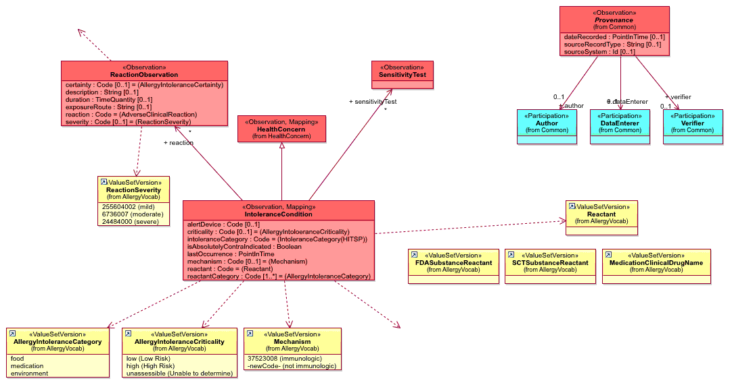
FHIM Allergy Domain Model
Describes an observation of an "Intolerance Condition" of the Patient. Intolerance Conditions are typically allergies, but the concept of an intolerance condition is broader than just allergies.

Slide 16
Model Driven Architecture (MDA)
MDA
(MDHT & MDMI)
CLINICAL
IMPACT
Consistent Representation of
UML Implementation Guides:
Provide a consistent approach for constraint-
based profiling using UML, thereby enabling
a common model-driven process and tooling.
Applicable to: CDA, FHIR, FHIM, CIMI, etc.
Development Cost Reduction:
Less time and resource investment for
analysis and implementation of CDA & FHIR
implementation guides
Maintenance Cost Reduction:
Access to high-quality, domain specific
APIs generated from specification models,
providing programmatic access to
content and validation of conformance rules
Support Design Tasks:
Import existing HL7 specs to UML
Integrate with terminology services to
define and reference value sets and codes
Generate instance validation tools from
specification models
Publish implementation guides in
multiple formats (PDF, XHTML, etc.)
Health
Information
Exchange
Interoperability Mapping:
Content mapping, traceability & gap analysis
between models via reference to
common semantic metadata
Clinical Decision
Support
Population – Health
Care Coordination
Specification
Designers
Research & Analytics
Developers /
Implementers
Quality – Outcome
Cost Measurements
Quality/Cost = Value
Learning Health
System

Slide 17
MDHT: UML Model for FHIR Standard

Slide 18
Import FHIR Specification to UML
Enhance MDHT to import HL7 FHIR specifications into a UML model
Automated transformation of FHIR structure definitions to UML
Includes “Core” resources and existing profiles (e.g. DAF)
May 20, 2016 FHIR STU3 draft used
Enhance MDHT to export FHIR StructureDefinition resources from UML model of profiles
Design UML stereotypes for representation of FHIR StructureDefinition (FHIR modeling language)
Required to extend UML for additional FHIR metadata

Slide 19
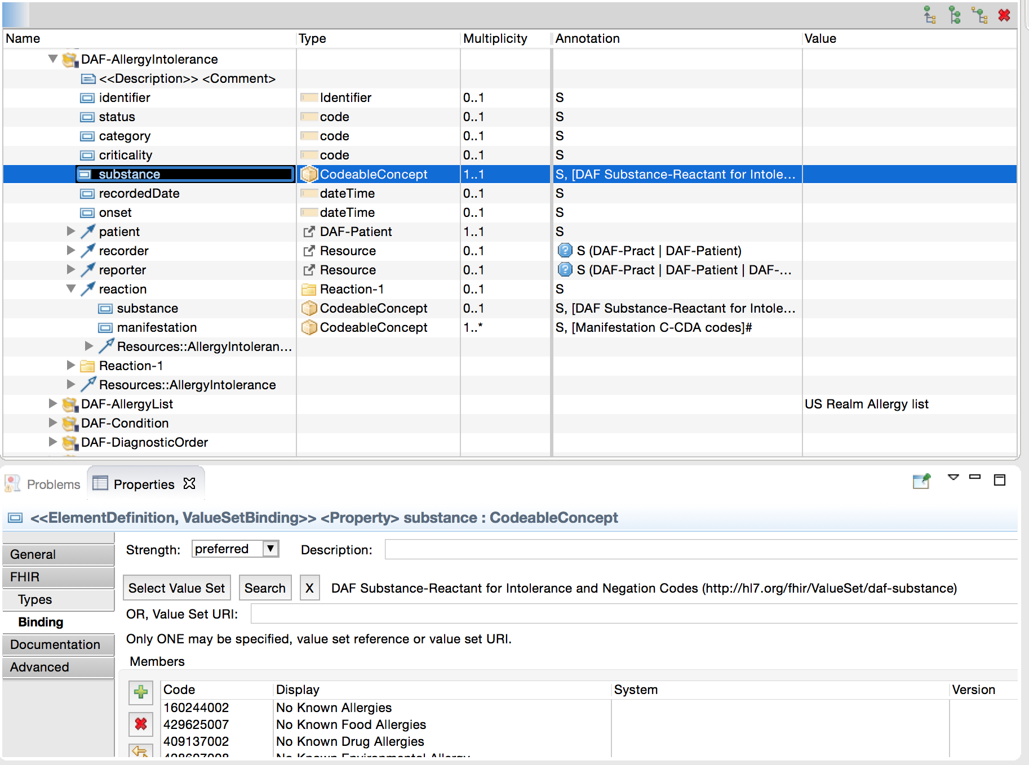
UML for DAF Allergy Intolerance

Slide 20
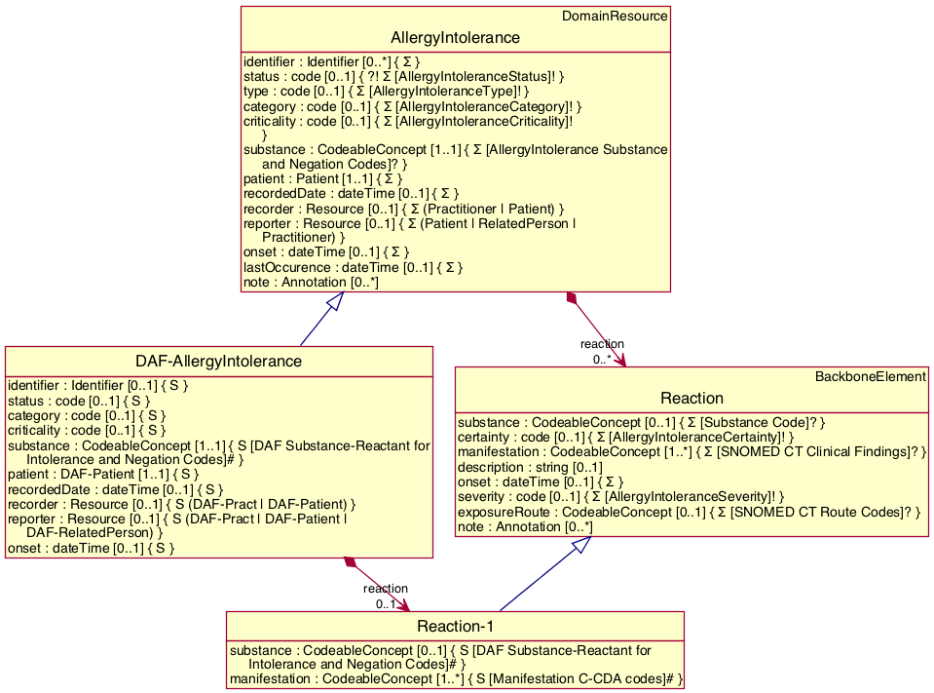
UML for DAF Allergy Intolerance

Slide 21
MDMI - Traceability and Gap Analysis

Slide 22
Traceability and Gap Report

Slide 23
Traceability and Gap Report
Delivered as an Excel Spreadsheet (the “Viewer”).
Rows in the Report
One row for every semantic element (e.g. each attribute in a FHIM class or element a FHIR resource)
The set of semantic elements in the report is the union of the semantic elements in source and target models.
Columns in the Report
Represent Metadata about the Semantic Elements. There are 4 sections
Section 1: Metadata about the MDMI Referent Index semantic elements (Business Elements).
Section 2: Metadata for semantic elements in source model (FHIM).
Section 3: Metadata for semantic elements in target model (FHIR).

Slide 24
Metadata for MDMI Business Elements
An MDMI Business Element is an unambiguous, unique semantic element. It is called a Business Element to differentiate from a Semantic Element in the mapped models.
Metadata for MDMI Business Elements (Columns in the Report):
Name of the Business Element
Description of the Business Element
Datatype for the Business Element
Terminology Binding when appropriate

Slide 25
Generating FHIR Profiles

Slide 26
FHIR Profile: What’s Needed
Generated FHIR profile fills the “gaps” between FHIM requirements and current HL7 standard FHIR DAF profile for Allergy Intolerance

Slide 27
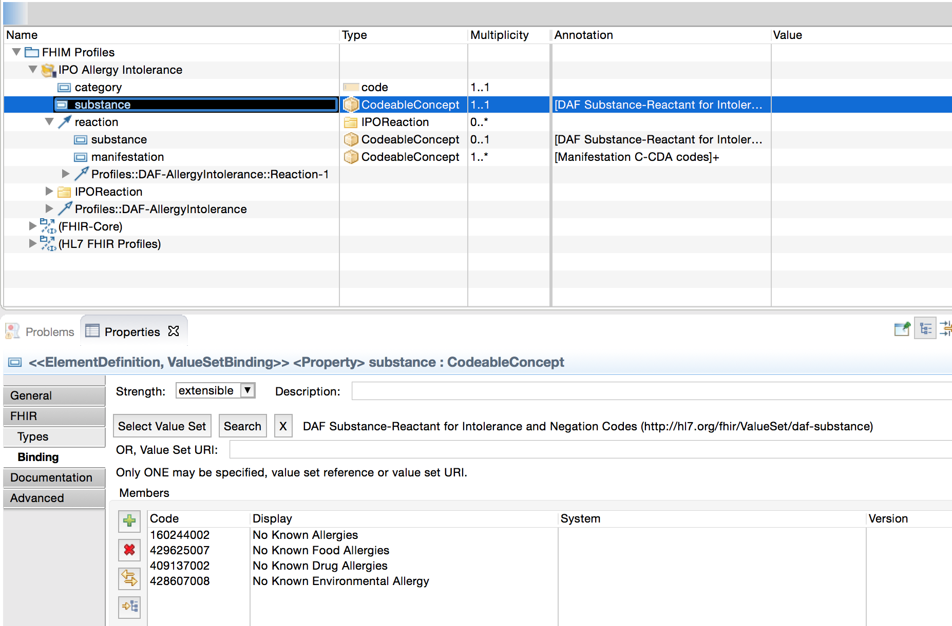
IPO Allergy Intolerance Profile

Slide 28
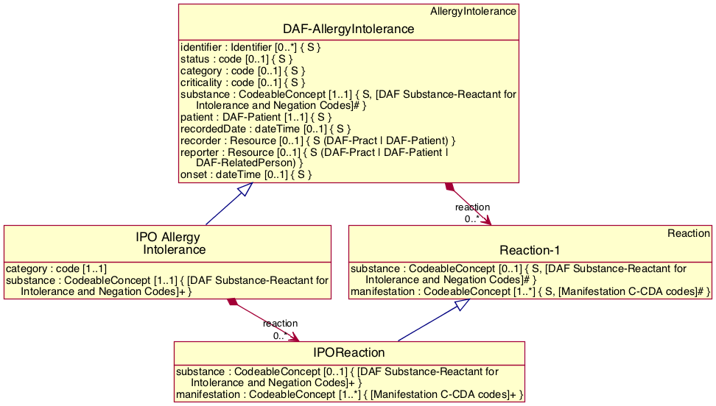
IPO Allergy Intolerance Profile

Slide 29
Generated FHIR Profile
<fhir:StructureDefinition xmlns:fhir="http://hl7.org/fhir">
<fhir:id value="ipo-allergy-intolerance"/>
<fhir:url value="http://eclipse.org/mdht/fhir/StructureDefinition/ipo-allergy-intolerance"/>
<fhir:name value="IPO Allergy Intolerance"/>
<fhir:status value="draft"/>
<fhir:publisher value="Model Driven Health Tools (MDHT)"/>
<fhir:date value="2016-05-25T15:40:35.843-06:00"/>
<fhir:kind value="resource"/>
<fhir:abstract value="false"/>
<fhir:baseType value="AllergyIntolerance"/>
<fhir:baseDefinition value="http://hl7.org/fhir/StructureDefinition/daf-allergyintolerance"/>
<fhir:derivation value="constraint"/>
<fhir:differential>
<fhir:element>
<fhir:path value="AllergyIntolerance"/>
<fhir:name value="IPO Allergy Intolerance"/>
<fhir:min value="0"/>
<fhir:max value="*"/>
<fhir:type>
<fhir:code value="AllergyIntolerance"/>
</fhir:type>
</fhir:element>
. . .

Slide 30
Applications USED in the process

Slide 31
MDHT: UML Model for FHIR

Slide 32
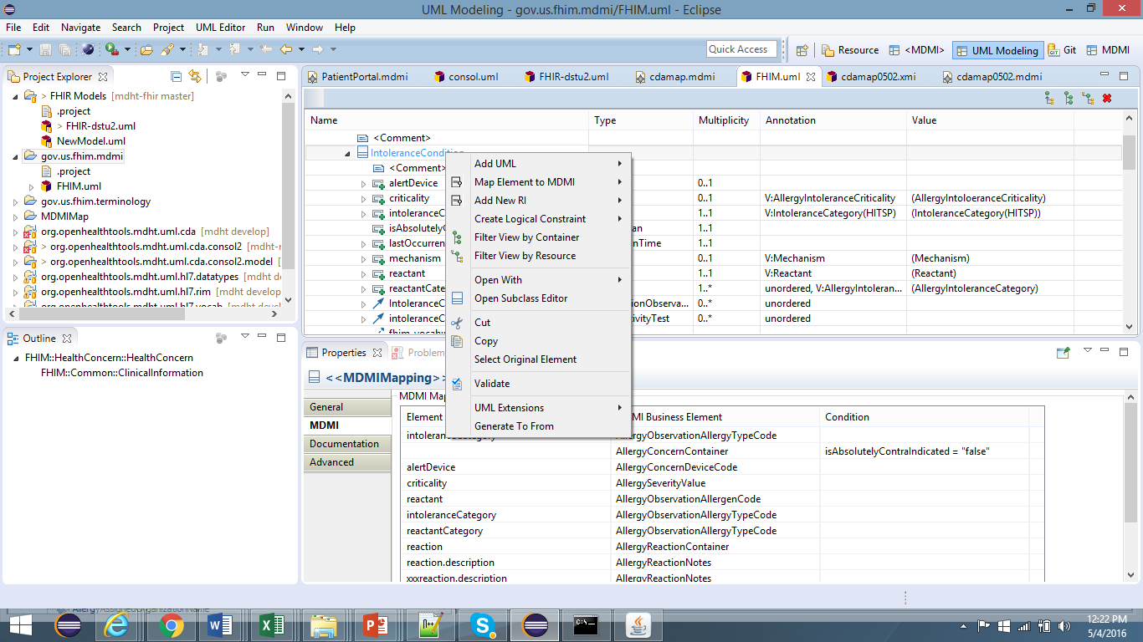
MDHT – MDMI RI annotation

Slide 33
MDHT – MDMI Model to Model Transformation
/FHIM.uml" />
<in uri="platform:/resource/org.openhealthtools.mdht.uml.cda.consol2.model/localri.xmi" />
<out uri="platform:/resource/org.mdmi.qvtcda/FHIMmap.xmi" />
<trace uri="platform:/resource/org.mdmi.qvtcda/FHIMmap.qvtotrace" ></trace>
<configProperty name="semanticRoot" value="AllergyIntolerance" />
<configProperty name="syntaxRoot" value="IntoleranceCondition" />
<configProperty name="mappingStyle" value="NORMAL" />
</qvto:transformation>

